Slide 1
Eli Chandler Sprint 006
July 26th –August 8th
Work hard rating 5/5

Slide 2
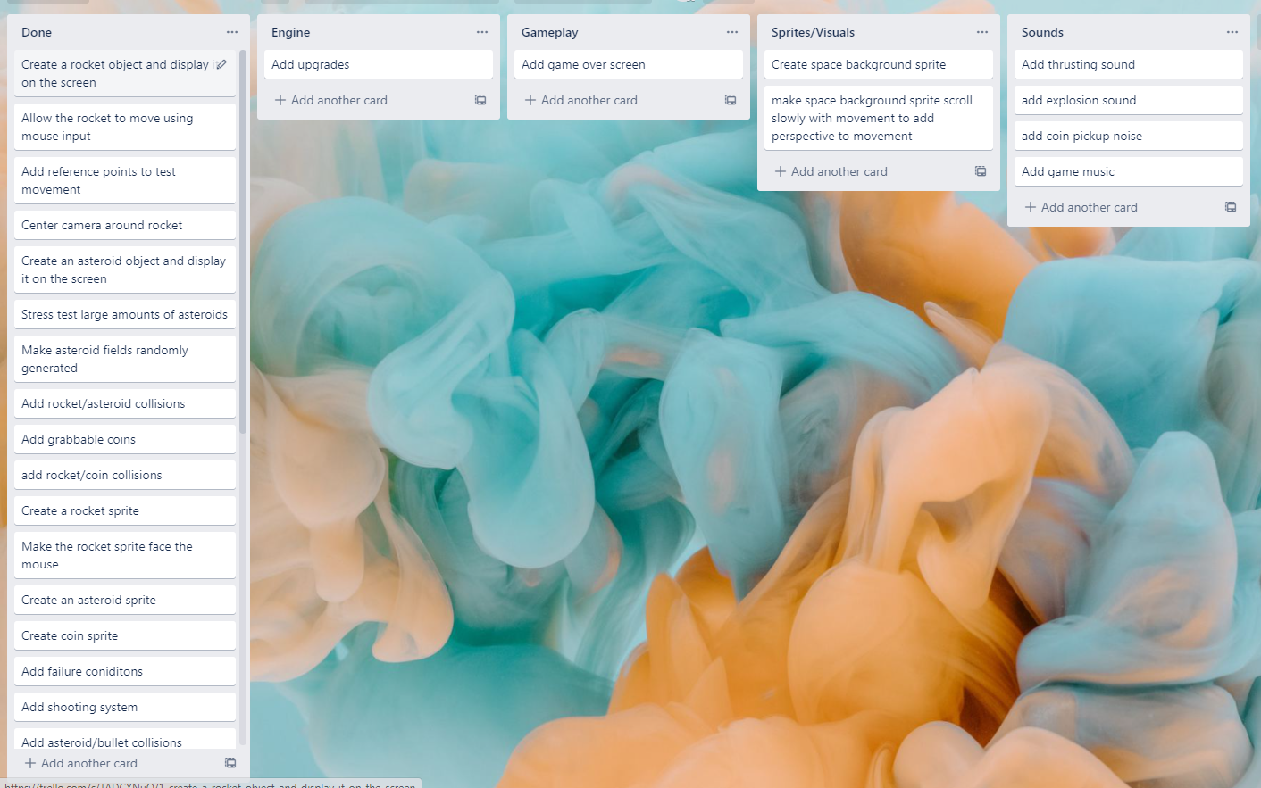
KANBAN Board at the start of the sprint

Slide 3
Sprint reflection and summary
During this sprint I added features that allow the game to have actual gameplay, the upgrades add a purpose to get coins and an incentive to not die, I also worked on the visuals of the game adding some new animations such as asteroids exploding when they collide with the earth and the scrolling stars. also now when you spawn in the screen is filled with asteroids instead of having to populate them off screen. I also converted my ‘base’ sprite to a planet class in a list of planets, this will allow me to easily add new planets to the game. I also added background music which makes it feel more like an actual game. I had a lot of issues with getting my buttons working but it taught me a lot about how item assignment works between objects.
Overall I think I accomplished a lot during this sprint and believe I am close to being able to deliver a final product.

Slide 4
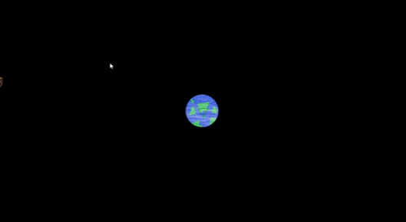
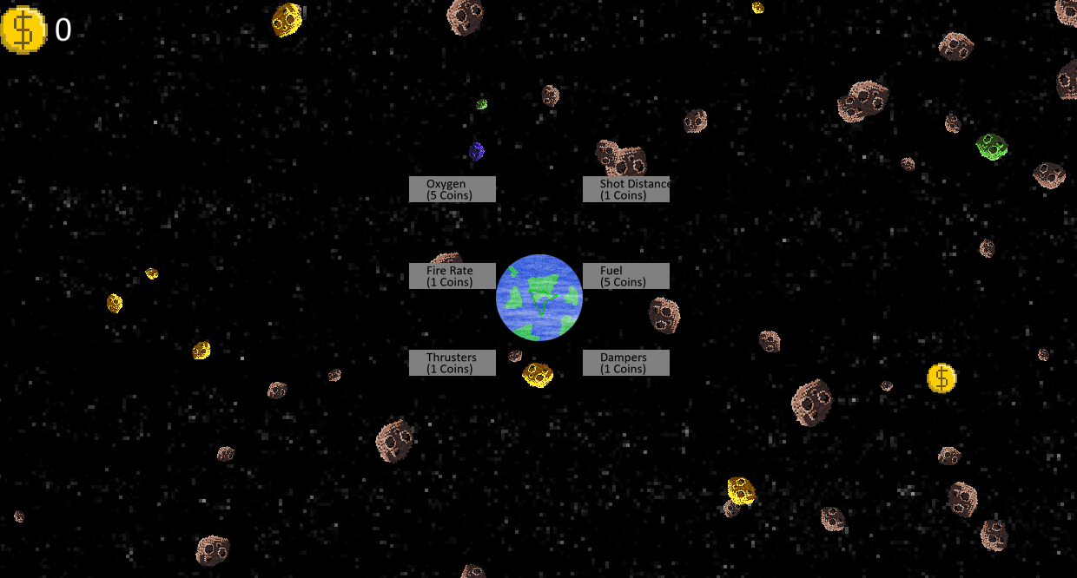
Major changes and achievements
Added working upgrade buttons
Added a coin counter so player can see their coins
Added various upgrades that improve the rockets survivability
Made asteroids explode on collision with earth
Asteroids populate on screen at the start of the game to get rid of the empty screen at the start of the game
Made planets class and spritelist based
Added music

Slide 5
Brief description of your testing
I had a lot of issues with my buttons, I had to make my own button class because the arcade.GUI buttons had issues with changing viewports which my game had.
Originally I was just passing in the attribute I wanted to change to the button, but I realized this wasn’t doing what I thought it was doing, passing in self.rocket.thrusters would pass in the literal value of that attribute (100) not the attribute itself
I fixed this by instead passing in the name of the upgrade, and than adding an upgrade function to the rocket, than I used setattr() within that function. This is better because I can use the upgrade function outside of the button class now if I want to upgrade without a button press, for example a rainbow asteroids that instantly upgrades a random attribute
Description of action | Expected output (Printed from game) | Actual output (Printed from game)
Add 100 to self.rocket.thrusters from button class (100+100) | 200 | 100
Set attribute ‘thrusters’ to value of ‘thrusters’ +100 in rocket class | 200 | 200

Slide 6
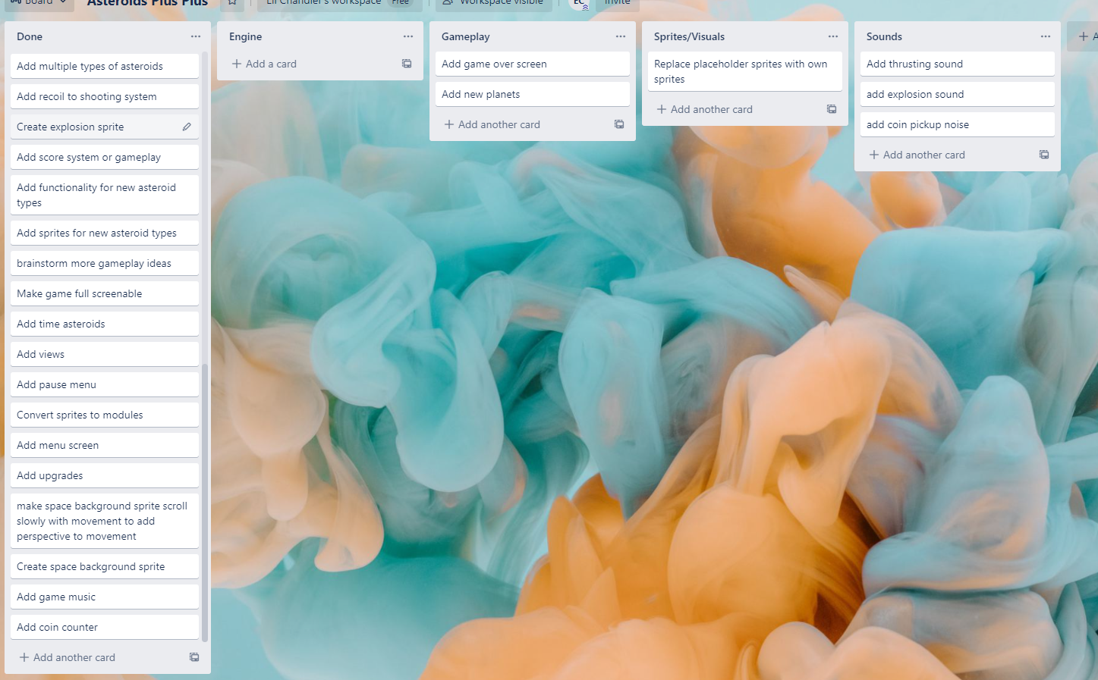
KANBAN Board at end of the sprint

Slide 7
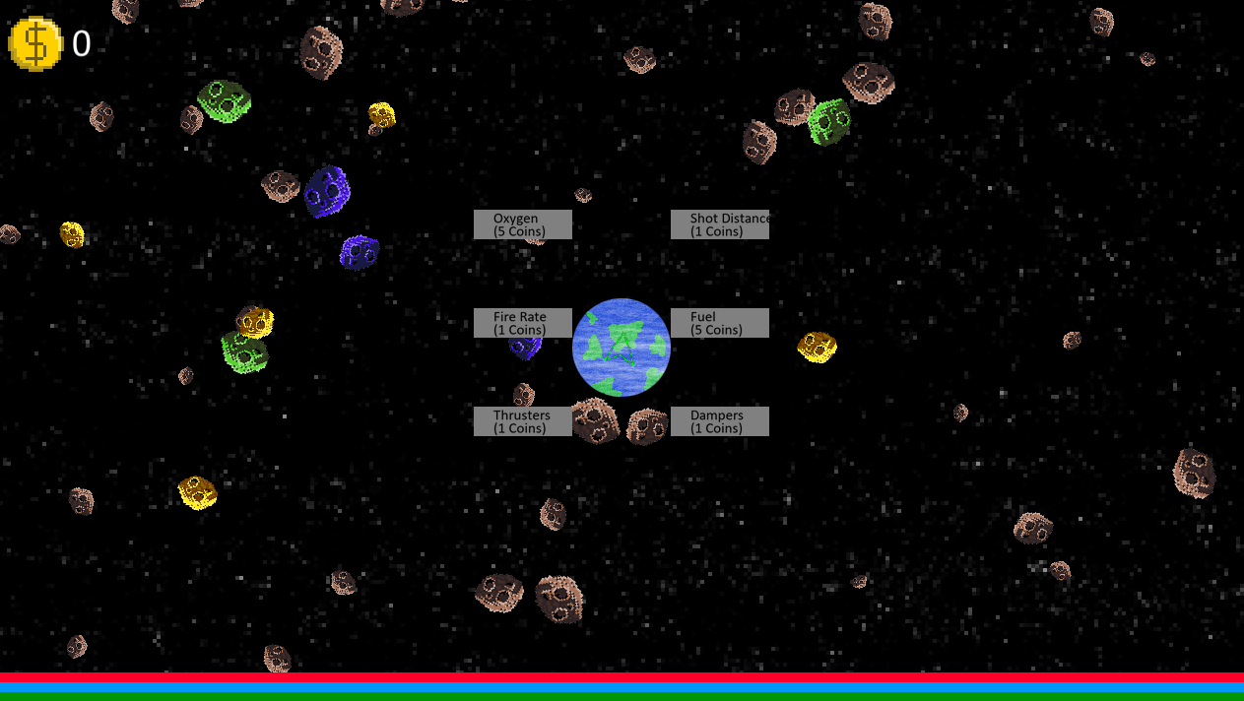
Screenshot of the game at the end of the sprint

Slide 8
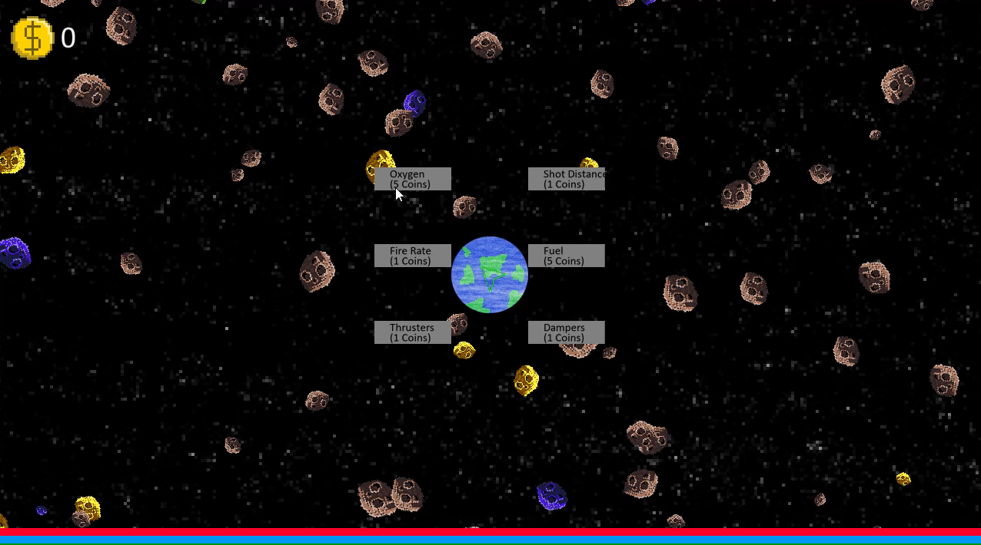
Video of the game at the end of the sprint

Slide 9
Notes for next time, future improvements
I got someone to test my game and they struggled after upgrading the thrusters a couple of times. I think that I need to make a way to change the thruster power, because when you upgrade the thrusters too much the game gets extremely hard because its so sensitive, I could use the scroll wheel to increase/decrease the overall thrusting

